Slide 1


Slide 2

4
MONITORING THE VALUE OF PRODUCTION: GDP
Notes:
Notes and teaching tips:4, 15, 26, 42, 48, 51, 52, 55, 56, 58, and 59.
To view a full-screen figure during a class, click the expand button.
To return to the previous slide, click the shrink button.
To advance to the next slide, click anywhere on the full screen figure.
Applying the principles of economics to interpret and understand the news is a major goal of the principles course. You can encourage your students in this activity by using the two features: Economics in the News and Economics in Action.
(1) Before each class, scan the news and select two or three headlines that are relevant to your session today. There is always something that works. Read the headline and ask for comments, interpretation, discussion. Pose questions arising from it that motivate today’s class. At the end of the class, return to the questions and answer them with the tools you’ve been explaining.
(2) Once or twice a semester, set an assignment, for credit, with the following instructions:
(a) Find a news article about an economic topic that you find interesting.
(b) Make a short bullet-list summary of the article.
(c) Write and illustrate with appropriate graphs an economic analysis of the key points in the article.
Use the Economics in the News features in your textbook as models.

Slide 3
After studying this chapter, you will be able to:
Define GDP and explain why GDP equals aggregate expenditure and aggregate income
Explain how the Bureau of Economic Analysis measures U.S. GDP and real GDP
Explain the uses and limitations of real GDP as a measure of economic well-being

Slide 4
Gross Domestic Product
GDP Defined
GDP or gross domestic product is the market value of all final goods and services produced in a country in a given time period.
This definition has four parts:
Market value
Final goods and services
Produced within a country
In a given time period
Notes:
The main challenge in teaching this topic is generating interest in it. Many teachers are bored by it and not surprisingly, they bore their students. If you are one of the many who lean toward boredom, start by recalling just how vital it is that we measure the value of production with reasonable accuracy. It is vital because we use GDP as the basis of measurement of the standard of living, economic welfare, and making international comparisons.
Final goods versus intermediate goods. The distinction between final and intermediate goods is one of the key points in this first section. Use some standard examples to make the key point—tires and autos, chips and computers, and so on. Also, if you want to spend a bit of time on this topic, tell your students about the Bureau of Economic Analysis (BEA) revision in the treatment of business spending on software.
The BEA began a major revision in 1998 and published the first revisions to reclassify software from intermediate to final good status in 1999. And, when the 1996 GDP was recalculated to include software, it increased by $115 billion, or 1.5 percent of GDP.

Slide 5
Gross Domestic Product
Market Value
GDP is a market value—goods and services are valued at their market prices.
To add apples and oranges, computers and popcorn, we add the market values so we have a total value of output in dollars.

Slide 6
Gross Domestic Product
Final Goods and Services
GDP is the value of the final goods and services produced.
A final good (or service) is an item bought by its final user during a specified time period.
A final good contrasts with an intermediate good, which is an item that is produced by one firm, bought by another firm, and used as a component of a final good or service.
Excluding the value of intermediate goods and services avoids counting the same value more than once.

Slide 7
Gross Domestic Product
Produced Within a Country
GDP measures production within a country—domestic production.
In a Given Time Period
GDP measures production during a specific time period, normally a year or a quarter of a year.

Slide 8
Gross Domestic Product
GDP and the Circular Flow of Expenditure and Income
GDP measures the value of production, which also equals total expenditure on final goods and total income.
The equality of income and value of production shows the link between productivity and living standards.
The circular flow diagram in Figure 4.1 illustrates the equality of income and expenditure.

Slide 9

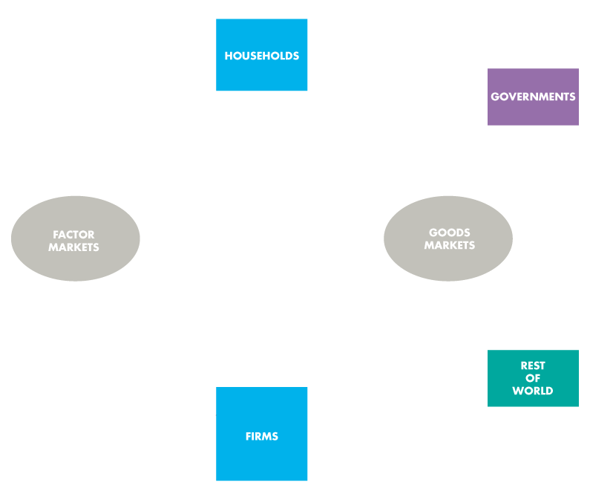

Gross Domestic Product
The circular flow diagram shows the transactions among households, firms, governments, and the rest of the world.

Slide 10
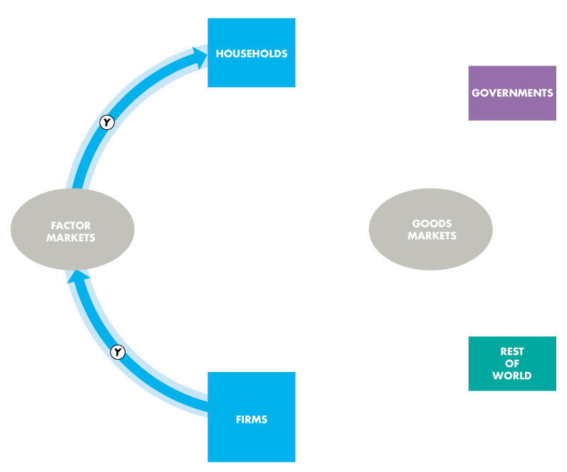
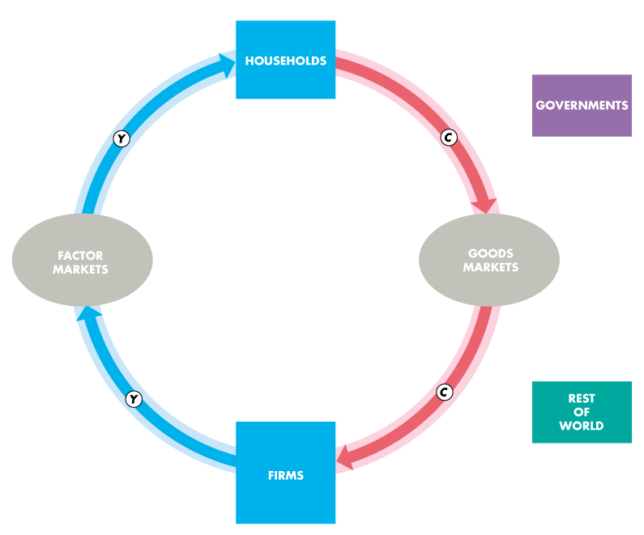
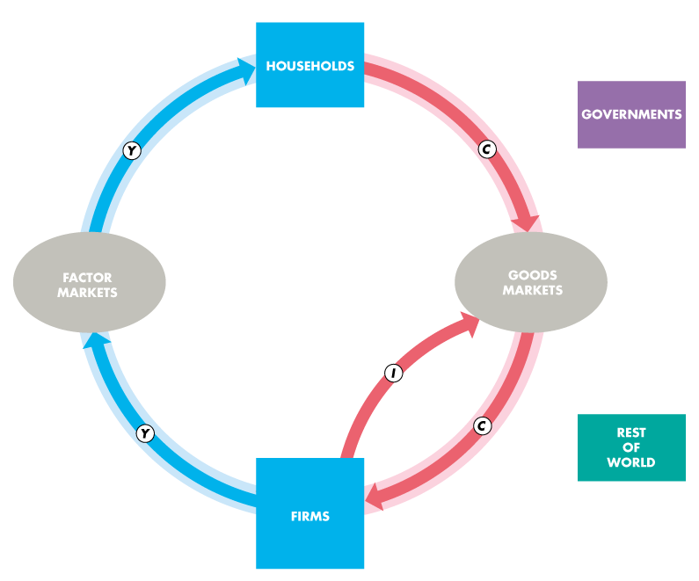
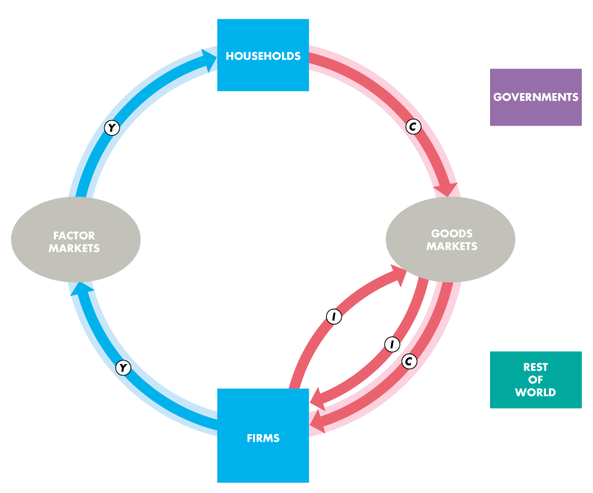
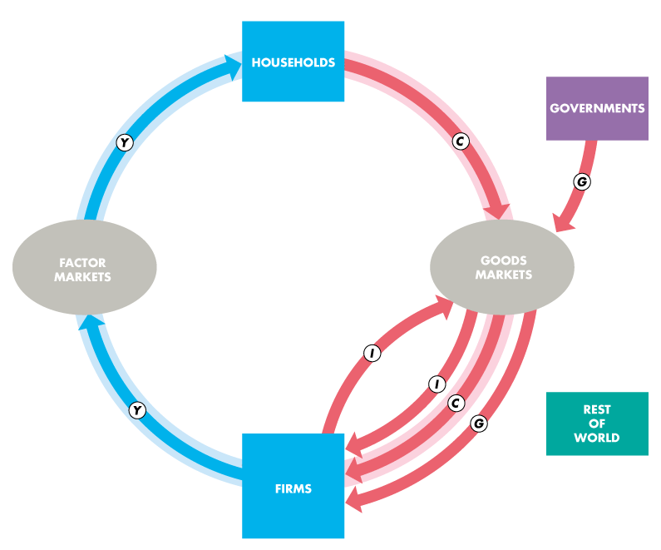

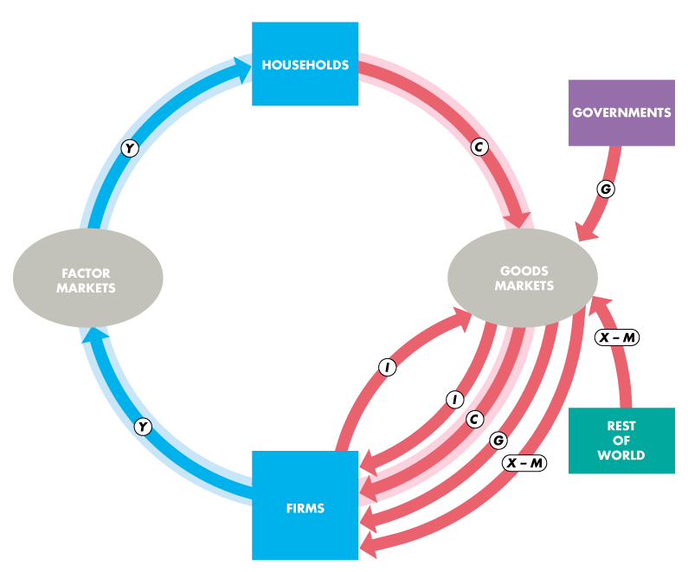

Slide 11
Gross Domestic Product
Households and Firms
Households sell and firms buy the services of labor, capital, and land in factor markets.
Firms pay wages for labor services, interest for the use of capital, and rent for the use of land.
A fourth factor of production, entrepreneurship, receives profit.
In the figure, the blue flow, Y, shows total income paid by firms to households.

Slide 12
Gross Domestic Product

Slide 13
Gross Domestic Product
Firms sell and households buy consumer goods and services in the goods market.
Consumption expenditure is the total payment for consumer goods and services, shown by the red flow labeled C .
Firms buy and sell new capital equipment in the goods market and put unsold output into inventory.
These purchases od new capital equipment and the additions to inventories are investment, shown by the red flow labeled I.

Slide 14
Gross Domestic Product

Slide 15
Gross Domestic Product
Governments
Governments buy goods and services from firms and their expenditure on goods and services is called government expenditure.
Government expenditure is shown as the red flow G.
Governments finance their expenditure with taxes and pay financial transfers to households, such as unemployment benefits, and pay subsidies to firms.
These financial transfers are not part of the circular flow of expenditure and income.
Notes:
Government transfer payments, such as Social Security payments, are not part of government expenditure because government expenditure includes only funds used by the government to buy goods and services. Transfer payments are not buying a good or service for the government and so are not included in government expenditures.

Slide 16
Gross Domestic Product

Slide 17
Gross Domestic Product
Rest of the World
Firms in the United States sell goods and services to the rest of the world—exports—and buy goods and services from the rest of the world—imports.
The value of exports (X ) minus the value of imports (M) is called net exports, the red flow (X – M).
If net exports are positive, the net flow of goods and services is from U.S. firms to the rest of the world.
If net exports are negative, the net flow of goods and services is from the rest of the world to U.S. firms.

Slide 18
Gross Domestic Product

Slide 19
Gross Domestic Product
The blue and red flows are the circular flow of expenditure and income.

Slide 20
Gross Domestic Product
The sum of the red flows equals the blue flow.

Slide 21
Gross Domestic Product
That is: Y = C + I + G + X – M

Slide 22
Gross Domestic Product
The circular flow shows two ways of measuring GDP.
GDP Equals Expenditure Equals Income
Total expenditure on final goods and services equals GDP.
GDP = C + I + G + X – M.
Aggregate income equals the total amount paid for the use of factors of production: wages, interest, rent, and profit.
Firms pay out all their receipts from the sale of final goods, so income equals expenditure,
Y = C + I + G + (X – M).

Slide 23
Gross Domestic Product
Why “Domestic” and Why “Gross”?
Domestic
Domestic product is production within a country.
It contrasts with national product, which is the value of goods and services produced anywhere in the world by the residents of a nation.
Gross
Gross means before deducting the depreciation of capital.
The opposite of gross is net, which means after deducting the depreciation of capital.

Slide 24
Gross Domestic Product
Depreciation is the decrease in the value of a firm’s capital that results from wear and tear and obsolescence.
Gross investment is the total amount spent on purchases of new capital and on replacing depreciated capital.
Net investment is the increase in the value of the firm’s capital.
Net investment = Gross investment − Depreciation.

Slide 25
Gross Domestic Product
Gross investment is one of the expenditures included in the expenditure approach to measuring GDP.
So total product measured by the expenditure approach is a gross measure.
Gross profit, which is a firm’s profit before subtracting depreciation, is one of the incomes included in the income approach to measuring GDP.
So total product measured by the income approach is a gross measure.

Slide 26
Measuring U.S. GDP
The Bureau of Economic Analysis uses two approaches to measure GDP:
The expenditure approach
The income approach
Notes:
Little is spent on measuring U.S. GDP. You might like to tell your students that the U.S. government spends very little on the measurement of real GDP. The BEA (in the Department of Commerce) employs fewer than 500 economists, accountants, statisticians, and IT specialists at an annual cost of less that $70 million. It costs each American less than 0.25¢ (a quarter of a cent) to measure the value of the nation’s production. For some further perspective, the National Oceanic and Atmospheric Administration (also in the Department of Commerce), whose mission is to “describe and predict changes in the Earth’s environment, and conserve and manage wisely the nation’s coastal and marine resources so as to ensure sustainable economic opportunities,” employs more than 11,000 scientists and support personnel at an annual cost of $3.2 billion!
Most of the income data used by BEA comes from IRS. Expenditure data comes from a variety of sources.
You might like to explain how the omission of illegal goods and services also leads to some misleading comparisons. For instance, the day before prohibition ended, the production of (illegal) beer was not counted as part of GDP. But the day after prohibition ended, the production of (now legal) beer counted. Ask your students to suggest two good reasons why illegal goods and services are omitted.
First, the data are hard (but not impossible) to obtain. Second, there may be the moral position that illegal activities should not be included in GDP. This latter observation can lead to an interesting discussion. Ask the students if they think that the production of, say, marijuana should be included in GDP. Some, maybe even many, of them will see no problem with this. Then ask about the production of murder-for-hire. The response, we hope, will be significantly different. Does such a good have any value?

Slide 27
Measuring U.S. GDP
The Expenditure Approach
The expenditure approach measures GDP as the sum of consumption expenditure, investment, government expenditure on goods and services, and net exports.
GDP = C + I + G + (X − M)
Figure 4.2 illustrates the expenditure approach.

Slide 28
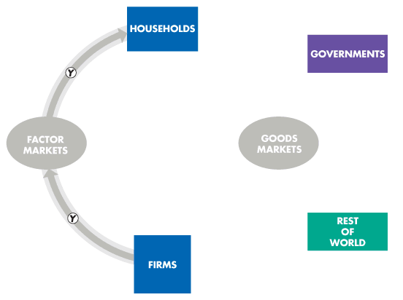
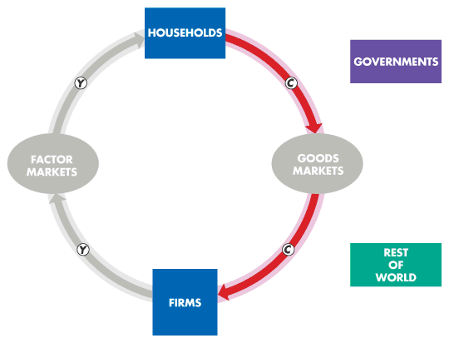
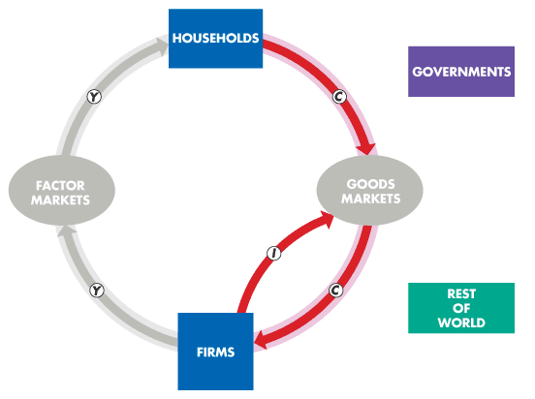
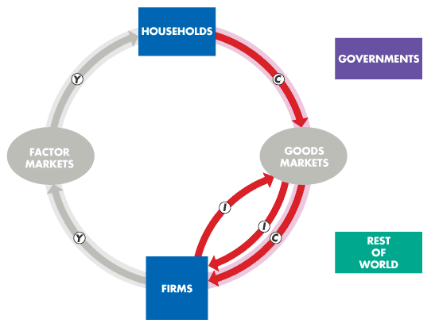
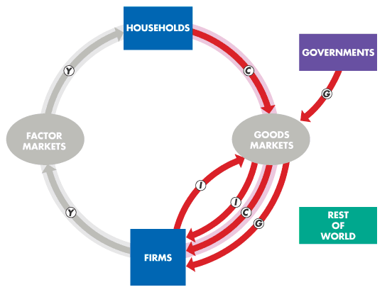
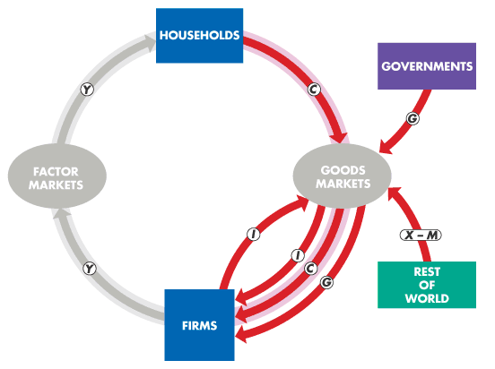
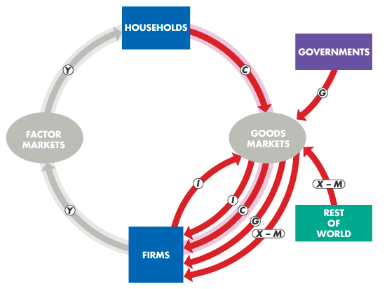
Measuring U.S. GDP
The expenditure approach measures GDP as the sum of the red flows: consumption expenditure, investment, government expenditure on goods and services, and net exports.
GDP = C + I + G + (X − M)
Table 4.1 on the next slide shows the expenditure approach with 2016 data.

Slide 30
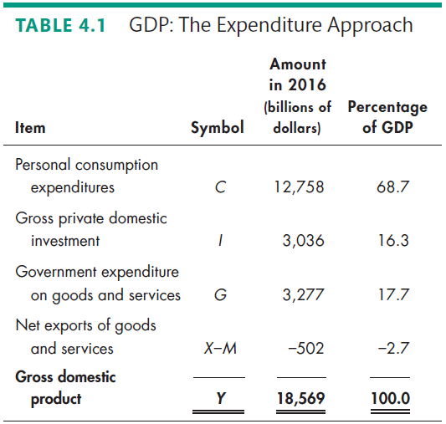

Slide 31
Measuring U.S. GDP
The Income Approach
The income approach measures GDP by summing the incomes that firms pay households for the factors of production they hire—wages for labor, interest for capital, rent for land, and profit for entrepreneurship.
Figure 4.3 illustrates the income approach.

Slide 32
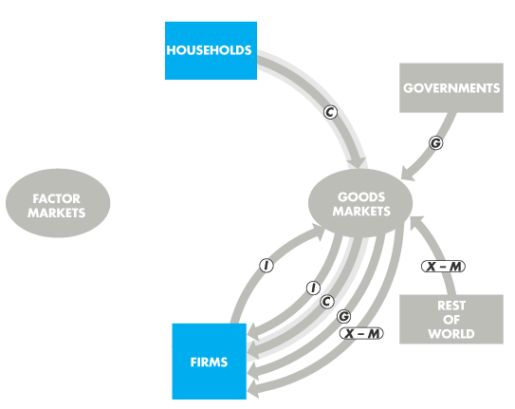
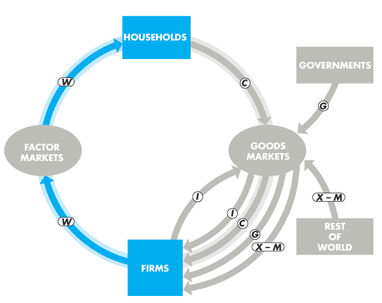
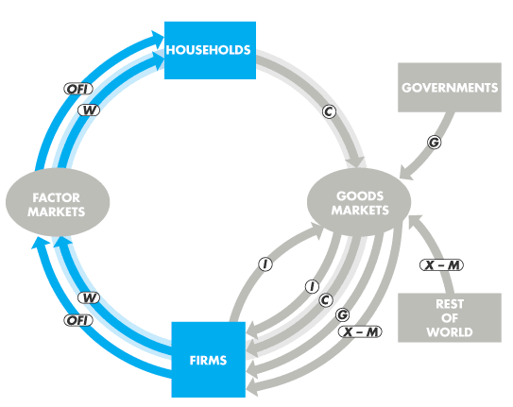
Measuring U.S. GDP
The payment for labor services is the sum of net wages plus benefits such as pension contributions and is shown by the blue flow W.
Other factor incomes include interest, rent, and profit and some labor income from self-employment.
They are included in the blue flow OFI.

Slide 34
Measuring U.S. GDP
The National Income and Expenditure Accounts divide incomes into two broad categories:
Compensation of employees is the payments for labor services. It is the sum of net wages plus taxes withheld plus Social Security and pension fund contributions.
Net interest, rental income, corporate profits, and proprietors' income earned by capital and land.

Slide 35
Measuring U.S. GDP
The sum of all factor incomes is net domestic income at factor cost.
The expenditure on final goods is valued at market prices.
Two adjustments must be made to the net domestic income get GDP:
Indirect taxes less subsidies are added to get from factor cost to market prices.
Depreciation is added to get from net domestic income to gross domestic income.
Table 4.2 on the next slide shows the income approach with data for 2016.

Slide 36
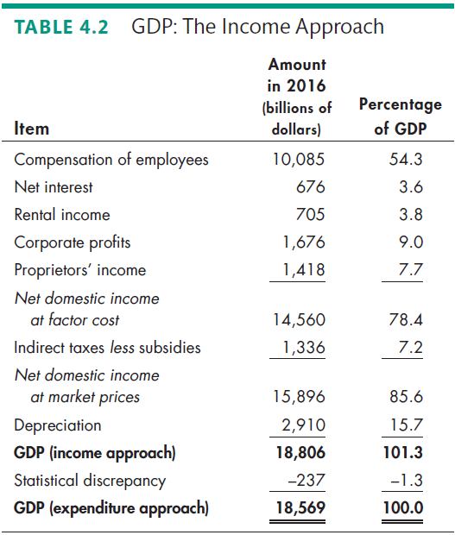

Slide 37
Measuring U.S. GDP
Nominal GDP and Real GDP
Real GDP is the value of final goods and services produced in a given year when valued at the prices of a reference base year.
Currently, the reference base year is 2009 and we describe real GDP as measured in 2009 dollars.
Nominal GDP is the value of goods and services produced during a given year valued at the prices that prevailed in that same year.
Nominal GDP is just a more precise name for GDP.

Slide 38
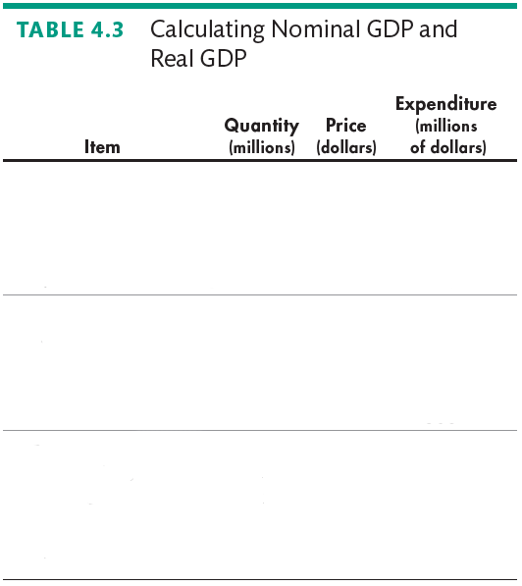
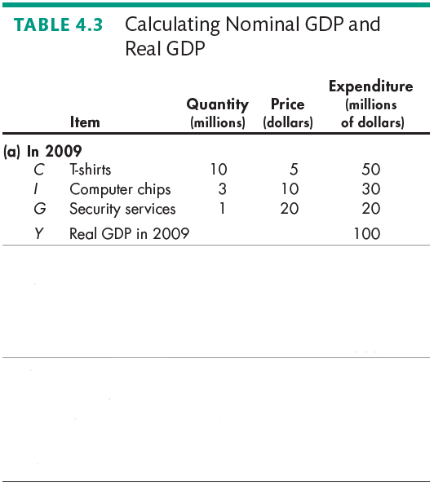
Measuring U.S. GDP
Calculating Real GDP
Table 4.3(a) shows the quantities produced and the prices in 2009 (the base year).
Nominal GDP in 2009 is $100 million.
Because 2009 is the base year, real GDP equals nominal GDP and is $100 million.

Slide 39
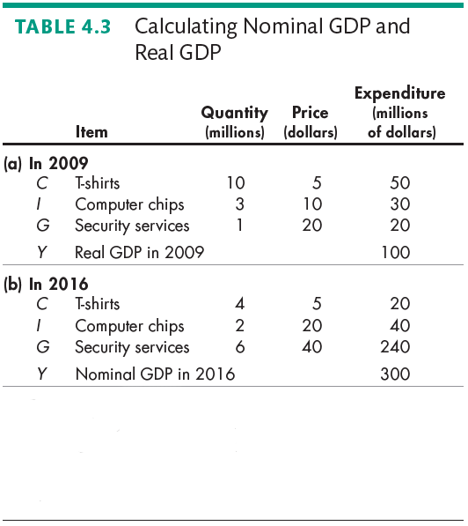
Measuring U.S. GDP
Table 4.3(b) shows the quantities produced and the prices in 2016.
Nominal GDP in 2016 is $300 million.
Nominal GDP in 2016 is three times its value in 2009.

Slide 40
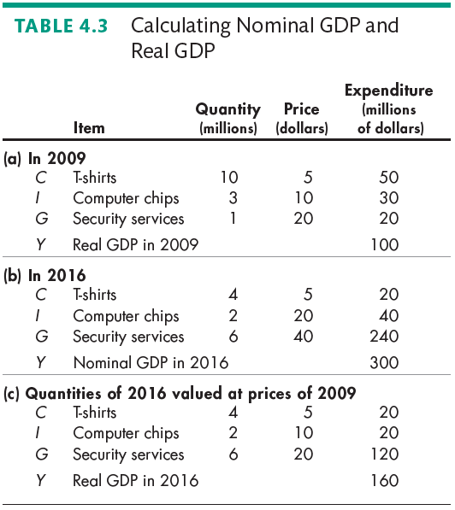
Measuring U.S. GDP
In Table 4.3(c), we calculate real GDP in 2016.
The quantities are those of 2016, as in part (b).
The prices are those in the base year (2009), as in part (a).
The sum of these expenditures is real GDP in 2016, which equals $160 million.

Slide 41
The Uses and Limitations of Real GDP
Economists use estimates of real GDP for two main purposes:
To compare the standard of living over time
To compare the standard of living across countries

Slide 42
The Uses and Limitations of Real GDP
The Standard of Living Over Time
Real GDP per person is real GDP divided by the population.
Real GDP per person tells us the value of goods and services that the average person can enjoy.
By using real GDP, we remove any influence that rising prices and a rising cost of living might have had on our comparison.
Notes:
Omissions from GDP. A discussion of omissions from GDP can arouse students’ interest. For example, you might point out that if one of your students mows her/his own lawn, the value of the student’s production doesn’t show up in GDP. But if you hire the student to mow your lawn (and if your student reports the income earned correctly to the IRS), the value of the student’s production does show up in GDP.
Why don’t we measure all lawn mowing as part of GDP? Some reasons are cost of collecting data and the degree of intrusiveness we’d be willing to tolerate. But note how little we spend on collecting the GDP data and how relatively inexpensive it would be to add some questions about domestic production to either the Current Population Survey or the Consumer Expenditure Survey.
The inclusion of the imputed rental of owner-occupied houses, but not owner-used cars and other durables, is a good example.
You might like to explain how the omission of illegal goods and services also leads to some misleading comparisons. For instance, the day before prohibition ended, the production of (illegal) beer was not counted as part of GDP. But the day after prohibition ended, the production of (now legal) beer counted. Ask your students to suggest two good reasons why illegal goods and services are omitted. First, the data are hard (but not impossible) to obtain. Second, there may be the moral position that illegal activities should not be included in GDP. This latter observation can lead to an interesting discussion. Ask the students if they think that the production of, say, marijuana should be included in GDP. Some, maybe even many, of them will see no problem with this. Then ask about the production of murder-for-hire. The response, we hope, will be significantly different. Does such a good have any value?
Classroom activity
Check out At Issue: Should GNNP Replace GDP?

Slide 43
The Uses and Limitations of Real GDP
Long-Term Trend
A handy way of comparing real GDP per person over time is to express it as a ratio of some reference year.
For example, in 1960, real GDP per person was $17,210 and in 2016, it was $51,538.
So real GDP per person in 2016 was 3 times its 1960 level—that is, $51,538 ÷ $17,210 = 3.

Slide 44
The Uses and Limitations of Real GDP
Two features of our expanding living standard are
The growth of potential GDP per person
Fluctuations of real GDP around potential GDP
The value of real GDP when all the economy’s labor, capital, land, and entrepreneurial ability are fully employed is called potential GDP.

Slide 45
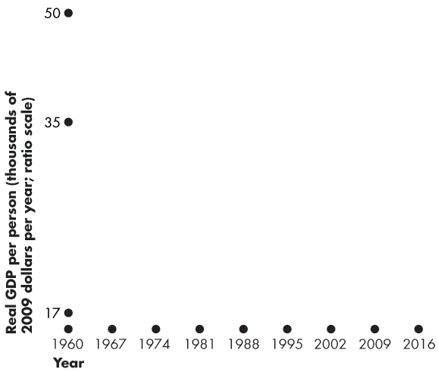
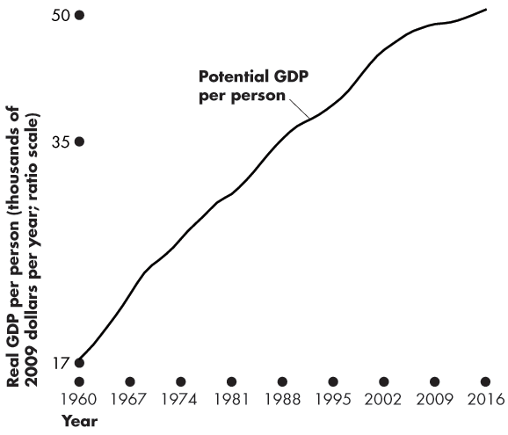
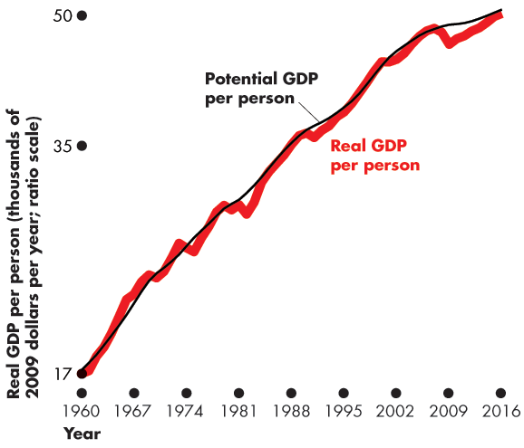
The Uses and Limitations of Real GDP
Figure 4.4 shows U.S. potential GDP per person.
Potential GDP per person grows at a steady pace because the quantities of the factors of production and their productivity grow at a steady pace.
U.S. real GDP per person fluctuates around potential GDP per person.

Slide 46
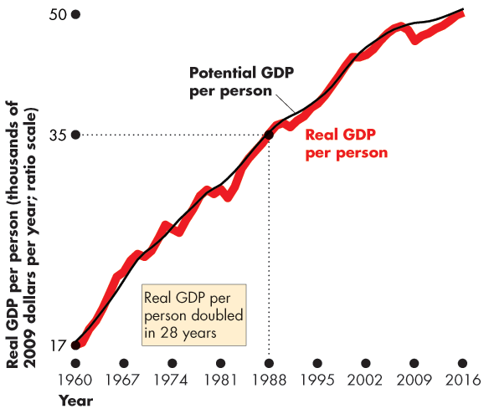
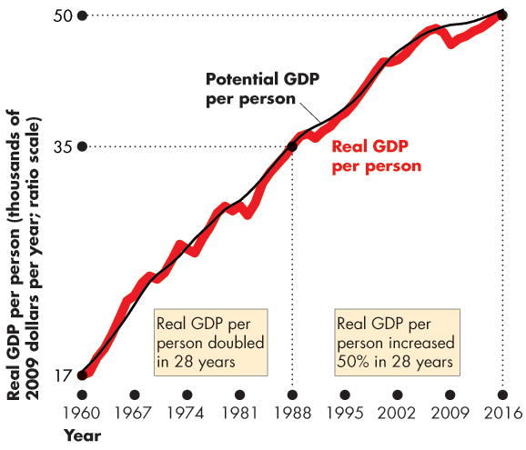

Slide 47
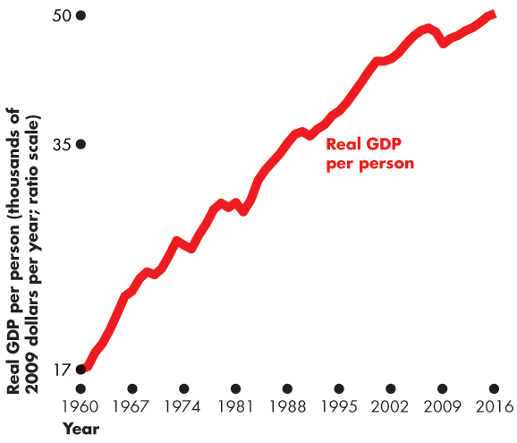
The Uses and Limitations of Real GDP
Potential GDP per person growth rate is not constant.
It slowed from 2.8 percent per year in the 1960s to 2.3 percent per year in the 1970s.
Real GDP per person:
Doubled between 1960 and 1988.
Was 3 times its 1960 level in 2016.

Slide 48
The Uses and Limitations of Real GDP
Productivity Growth Slowdown
The growth rate of real GDP per person slowed after 1970. How costly was that slowdown?
The answer is provided by a number that we’ll call the Lucas wedge.
The Lucas wedge is the dollar value of the accumulated gap between what real GDP per person would have been if the 1960s growth rate had persisted and what real GDP per person turned out to be.
Notes:
The Importance of the Lucas Wedge It is usually straightforward to interest students in the business cycle. But it is perhaps a bit more difficult to motivate interest in economic growth and the Lucas wedge. Yet economic growth and the Lucas wedge should be of immense importance to young students because they help determine the long-run living standard of their lives. One way to make this point clear is to ask the students whether the difference between, say, 3 percent annual growth in income versus 4 percent annual growth is important.
This difference probably does not sound important. But, suppose that the initial income was $35,000. After 10 years with growth of 3 percent a year, the income would be $47,037 and with growth of 4 percent a year, the income would be $51,809. This difference of about $4,500 might not seem like much. But point out to the students that this difference is for only ten years and that the annual difference will continue to enlarge: After 30 years with 3 percent growth, the income would be $84,954 and with 4 percent growth the income would be $113,519, a one year difference of about $40,000. And, over a 30-year working career, the total differences in income, which is the analog to the Lucas wedge, is approximately $420,000.
Over a 40-year working career, the Lucas wedge difference is over $1,000,000! Viewed from this perspective, the seemingly slight 1 percentage point difference in growth rates makes for an incredibly major difference in incomes, which should easily capture your students’ attention.

Slide 49
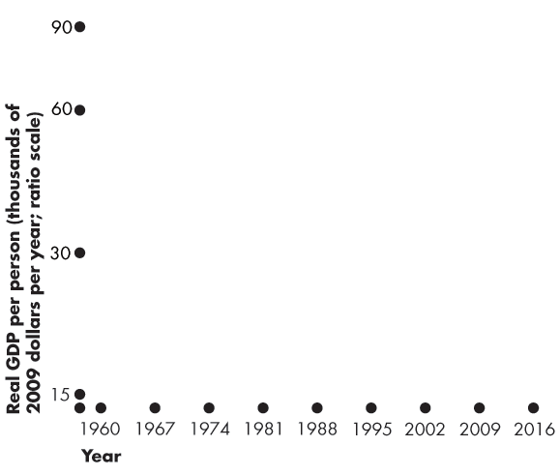
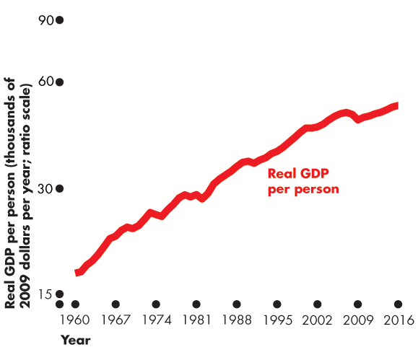
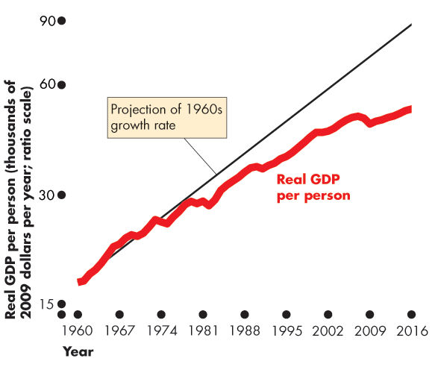
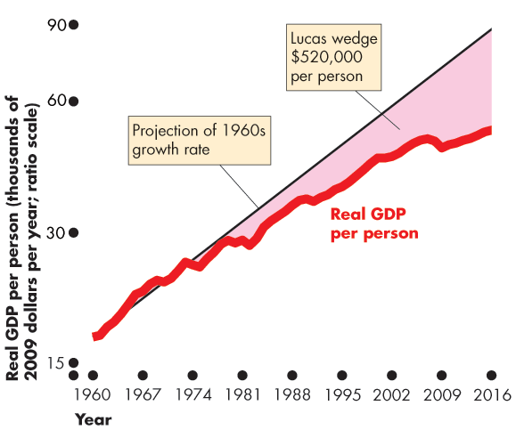
The Uses and Limitations of Real GDP
Figure 4.5 illustrates the Lucas wedge.
The red line is actual real GDP per person.
The thin black line is the trend that real GDP per person would have followed if the 1960s growth rate of potential GDP had persisted.
The shaded area is the Lucas wedge.

Slide 51
The Uses and Limitations of Real GDP
Real GDP Fluctuations—The Business Cycle
A business cycle is a periodic but irregular up-and-down movement of total production and other measures of economic activity.
Every cycle has two phases: 1. Expansion 2. Recession
and two turning points: 1. Peak 2. Trough
Notes:
The Business Cycle Students generally are interested in the topic of business cycles, particularly if the economy happens to be in a recession when this chapter is covered. Often it is very difficult to tell the future path of the economy. Stress to the students that it is not stupidity on the part of economists that prevents us from knowing where the economy is heading. Rather it is the fact that forecasting is difficult for at least two reasons.
First, different sectors of the economy frequently send different signals. For instance, retail sales may be down, signaling a start to a recession, but housing starts may be up, indicating that an expansion will continue for a while.
Second, the data that must be used always are at least a bit out-of-date. For example, the preliminary estimate of GDP is not made until approximately six weeks after the end of the quarter, and the final revision of GDP doesn’t appear until years later.
Although economists’ forecasts are much better than those of others, forecasting GDP with complete accuracy is unlikely. Conclude by mentioning that this fact is important in later chapters when we discuss implementation of countercyclical policies.

Slide 52
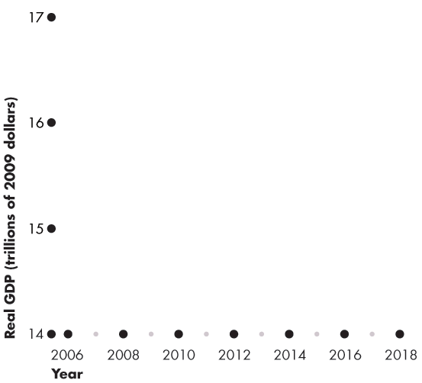
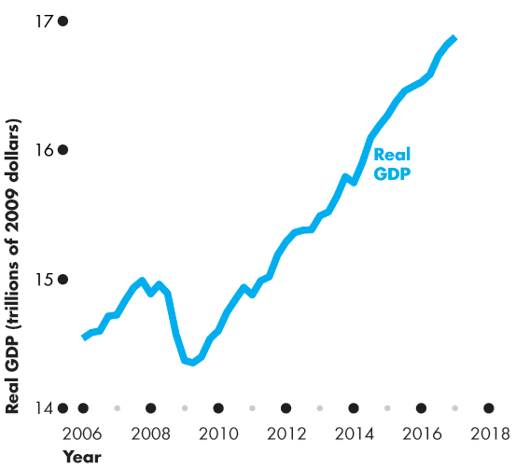
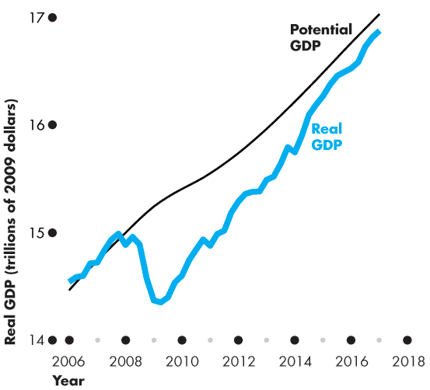
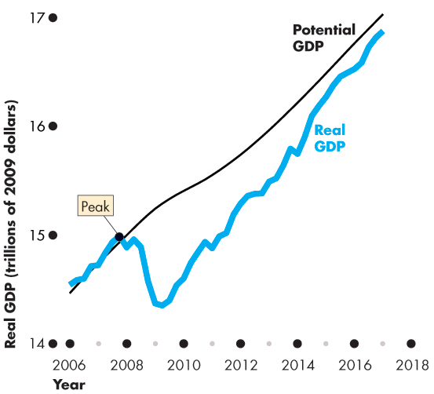
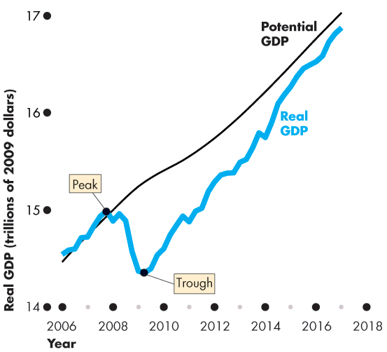
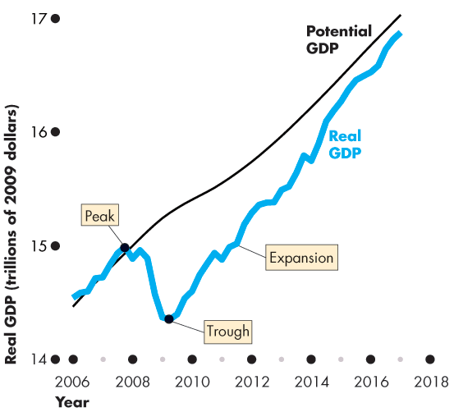
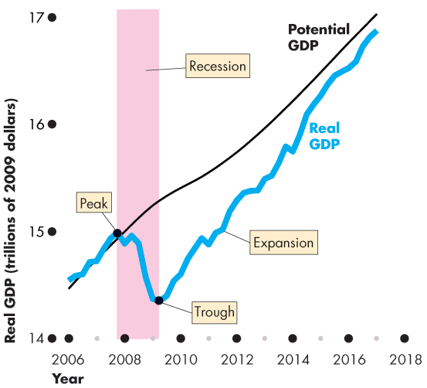
The Uses and Limitations of Real GDP
Figure 4.6 illustrates the business cycle.
An expansion is a period during which real GDP increases—from a trough to a peak.
Recession is a period during which real GDP decreases—its growth rate is negative for at least two successive quarters.
Notes:
Classroom activity
Check out Economics in the News: Real GDP Continues to Grow Slowly

Slide 54
The Uses and Limitations of Real GDP
The Standard of Living Across Countries
Two problems arise in using real GDP to compare living standards across countries:
1. The real GDP of one country must be converted into the same currency units as the real GDP of the other country.
2. The goods and services in both countries must be valued at the same prices.

Slide 55
The Uses and Limitations of Real GDP
Using the exchange rate to compare GDP in one country with GDP in another country is problematic because …
prices of particular products in one country may be higher or lower more than in the other country.
For example, using the market exchange rate to value China’s GDP in U.S. dollars leads to an estimate that in 2016, GDP per person in the United States was 6.3 times GDP per person in China.
Notes:
International comparisons and PPP prices. Students sometimes see estimates of GDP per person in developing nations. Most such estimates are extremely low, and students often ask how people can live on such low incomes.
Point out that the estimate is biased downward in two ways.
First, in poor nations, more transactions do not go through a market than in rich nations. For example, transportation services in developing nations include a lot of walking, which is not counted as part of GDP. In richer nations, people ride a bus or subway and pay a fare, which is counted as part of GDP.
Second, many locally produced and consumed goods and services have extremely low prices in poor nations. For example, a haircut that costs $20 in New York might cost $1 in Calcutta. (You might get a better haircut in New York, but probably not one that is 20 times better!) Converting Indian GDP into U.S. dollars at the market exchange rate leaves this bias in the data. Using purchasing power parity prices to convert India’s GDP into U.S. dollars avoids this bias.

Slide 56
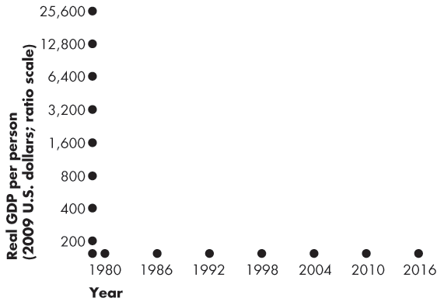
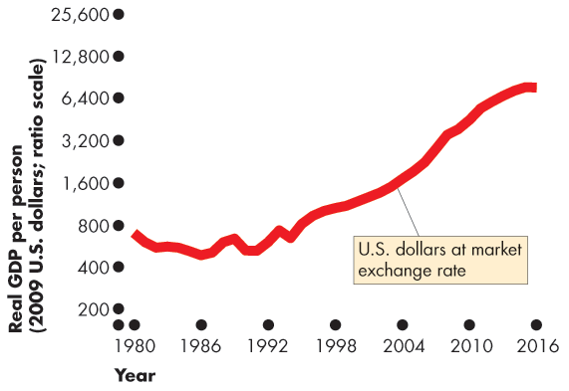
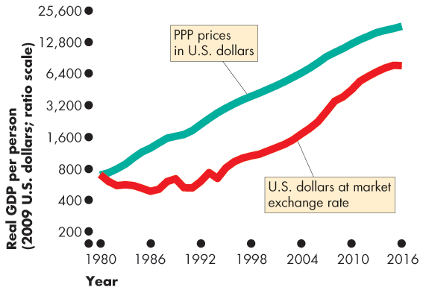
The Uses and Limitations of Real GDP
Figure 4.7 illustrates the problem.
Using the market exchange rate and domestic prices makes China look like a poor developing country.
But when GDP is valued at purchasing power parity prices, U.S. income per person is only 3.8 times that in China.
Notes:
The difference in the two sets of numbers is astonishingly large and makes a dramatic difference to how we view the balance of economic power over the next 25 years.
At current growth rates and market exchange rates, by 2020, China will have a GDP around a quarter that of the United States.
At current growth rates and PPP exchange rates, by 2020, China’s real GDP will exceed that of the United States.
Per person, China in 2020 will still have a long way to go to catch the United States. But China’s economy will be the world’s largest.

Slide 58
The Uses and Limitations of Real GDP
Limitations of Real GDP
Real GDP measures the value of goods and services that are bought in markets.
Some of the factors that influence the standard of living and that are not part of GDP are
Household production
Underground economic activity
Leisure time
Environmental quality
Notes:
Omissions from GDP. A discussion of omissions from GDP can arouse students’ interest. For example, you might point out that if one of your students mows her/his own lawn, the value of the student’s production doesn’t show up in GDP. But if you hire the student to mow your lawn (and if your student reports the income earned correctly to the IRS), the value of the student’s production does show up in GDP.
Why don’t we measure all lawn mowing as part of GDP? Some reasons are cost of collecting data and the degree of intrusiveness we’d be willing to tolerate. But note how little we spend on collecting the GDP data and how relatively inexpensive it would be to add some questions about domestic production to either the Current Population Survey or the Consumer Expenditure Survey.
The inclusion of the imputed rental of owner-occupied houses, but not owner-used cars and other durables, is a good example.
You might like to explain how the omission of illegal goods and services also leads to some misleading comparisons. For instance, the day before prohibition ended, the production of (illegal) beer was not counted as part of GDP. But the day after prohibition ended, the production of (now legal) beer counted. Ask your students to suggest two good reasons why illegal goods and services are omitted. First, the data are hard (but not impossible) to obtain. Second, there may be the moral position that illegal activities should not be included in GDP. This latter observation can lead to an interesting discussion. Ask the students if they think that the production of, say, marijuana should be included in GDP. Some, maybe even many, of them will see no problem with this. Then ask about the production of murder-for-hire. The response, we hope, will be significantly different. Does such a good have any value?
Classroom activity
Check out At Issue: Should GNNP Replace GDP?

Slide 59
The Uses and Limitations of Real GDP
The Bottom Line
Do we get the wrong message about the level and growth of economic well-being and the standard of living by looking at the growth of real GDP?
The influences that are omitted from real GDP are probably large.
It is possible to construct broader measures that combine the many influences that contribute to human happiness.
Despite all the alternatives, real GDP per person remains the most widely used indicator of economic well-being.
Notes:
Classroom activity
Check out Economics in Action: A Broader Indicator of Economic Well-Being

Slide 60
Mathematical Note: Chained-Dollar Real GDP
The BLS uses a measure of real GDP called chained-dollar real GDP.
Three steps are needed to calculate this measure:
Value production in the prices of adjacent years
Find the average of two percentage changes
Link (chain) back to the reference year

Slide 61
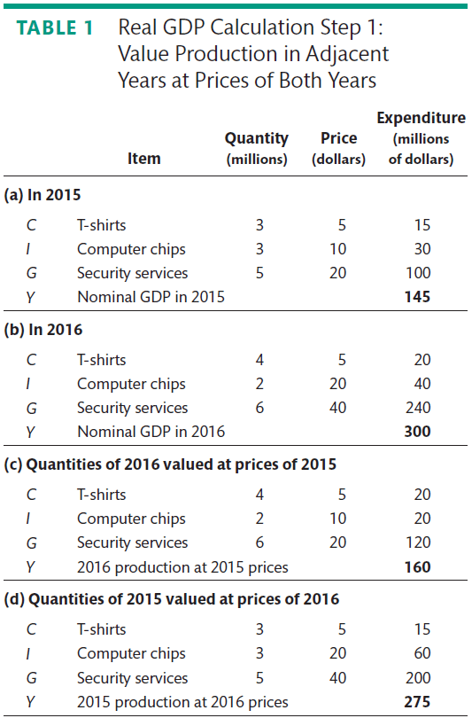
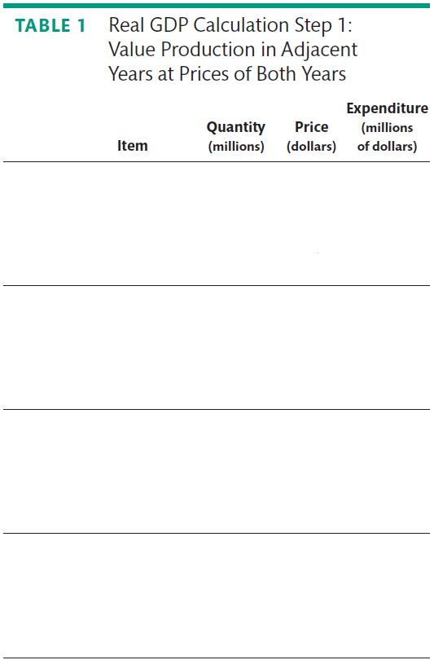
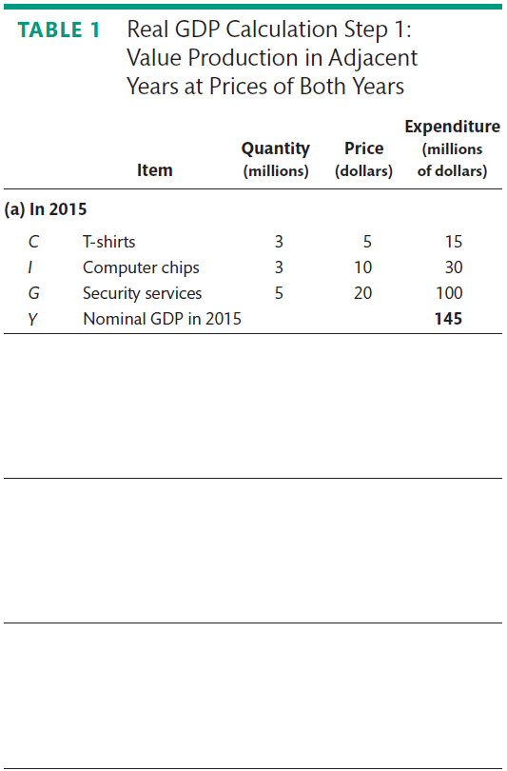
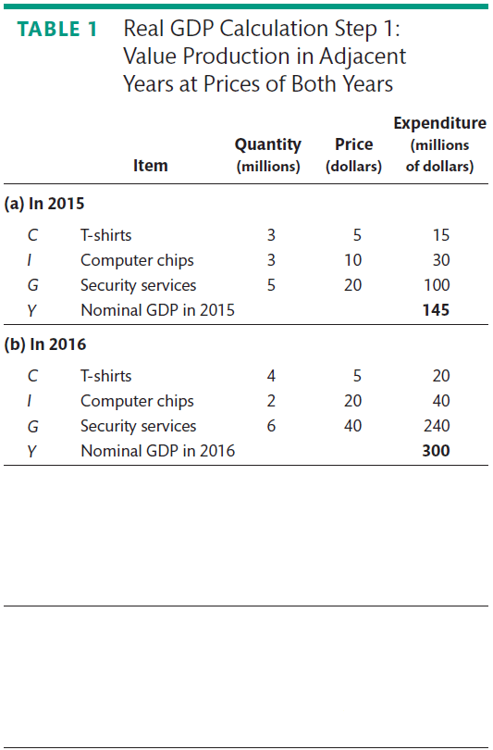
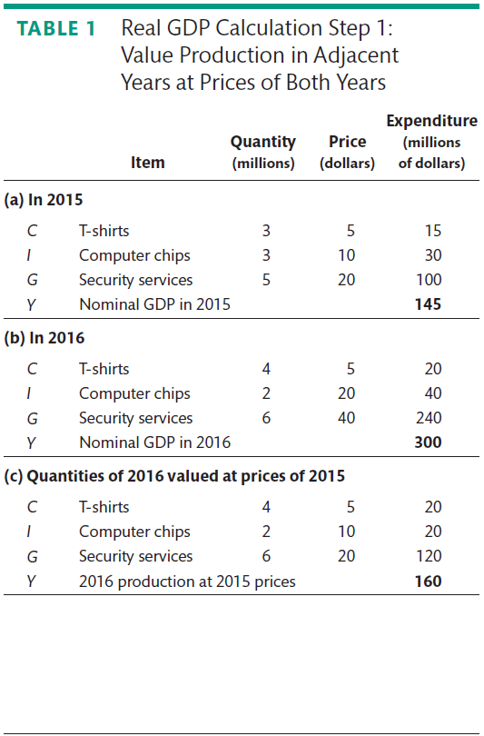
Mathematical Note: Chained-Dollar Real GDP
Value Production in Prices of Adjacent Years
Part (a) shows the quantities and prices in 2015.
Part (b) shows the quantities and prices in 2016.
Part (c) the quantities of 2016 valued at 2015 prices.
Part (d) the quantities of 2015 valued at prices of 2016.

Slide 62
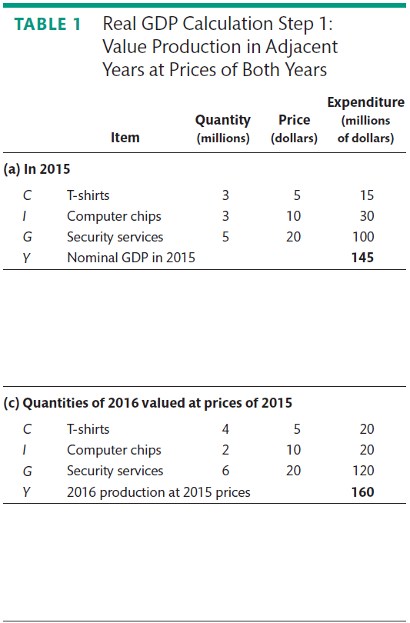
Mathematical Note: Chained-Dollar Real GDP
Parts (a) and (c) value the quantities of both years at 2015 prices.
That is, in 2015 prices, real GDP increased from $145 million to $160 million.

Slide 63
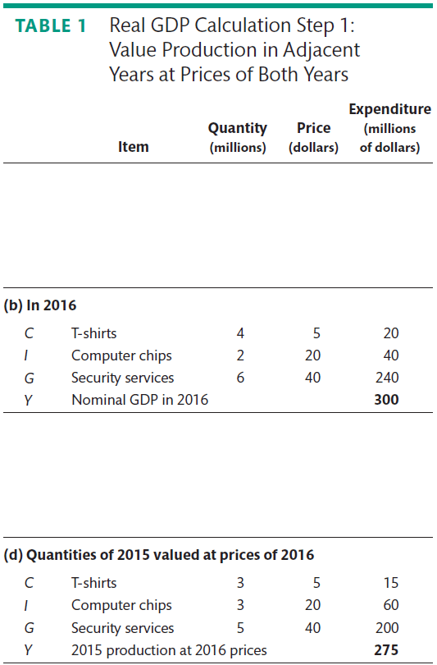
Mathematical Note: Chained-Dollar Real GDP
Parts (d) and (b) value the quantities in both years at 2016 prices.
That is, in 2016 prices, real GDP increased from $275 million to $300 million.

Slide 64




Mathematical Note: Chained-Dollar Real GDP
Find the Average of Two Percentage Changes
Part (a) shows that at 2015 prices, production increased by 10.3%.
Part (b) shows that at 2016 prices, production increased by 9.1%.
The average increase in production is 9.7%.

Slide 65
Mathematical Note: Chained-Dollar Real GDP
Link (Chain) to the Base Year
To find real GDP in 2016 in base-year prices (2009), we need to know
1. Real GDP in 2009
2. Average growth rate each year from 2009 to 2016.
The BEA must calculate the percentage change of the growth rate in real GDP for each pair of years from the base year to the most recent year.
To find real GDP for years before the base year, the BEA must calculate the growth rates for each pair of years back to the earliest one available.

Slide 66









Mathematical Note: Chained-Dollar Real GDP
Finally, using the average growth rates that it has calculated, the BEA finds the real GDP in each year in 2009 prices by linking them to the real GDP in 2009.
The figure shows an example.

Slide 67
Graphs in Macroeconomics

Slide 68
After studying this chapter, you will be able to:
Make and interpret a times-series graph
Make and interpret a graph that uses a ratio scale

Slide 69





The Time-Series Graph
Making a Time-Series Graph
A time-series graph measures
Time on the x-axis
The variable in which we are interested on the y-axis.

Slide 71
The Time-Series Graph
Reading a Time-Series Graph
A time-series graph shows the
Level of the variable
Change in the variable
Speed of change in the variable

Slide 72
The Time-Series Graph
Ratio Scale Reveals Trend
A time-series graph also reveals whether a variable has a
Cycle—a tendency for a variable to alternate between upward and downward movements
Trend—a tendency for a variable to move in one general direction

Slide 73


The Time-Series Graph
This time-series graph has
A cycle
No trend

Slide 74



The Time-Series Graph
A Time-Series with a Trend
Figure A4.2(a) shows the average prices paid by consumers from1970 to 2016.
In 1970, the price is set at 100.
The price in other years is measured as a percentage of the 1970 level.
Prices look as if they rose at a fairly constant rate.

Slide 75



Slide 76




The Time-Series Graph
Using a Ratio Scale
On the y-axis of a normal graph, the gap between 100 and 200 is the same as that between 300 and 400.
On a graph with a ratio scale, the gap between 100 and 200 is same as that between 200 and 400.
The ratio of 200 to 100 equals the ratio of 400 to 200—a constant ratio gap.

Slide 77




The Time-Series Graph
Graphing data on a ratio scale reveals the trend.
The steeper the line, the faster is the rate at which prices are rising.
Prices rose rapidly in the 1970s and early 1980s and more slowly in the late 1980s, 1990s, and 2000s.

